Slide 1
Unit 14 Transformers
Part B – Transformer Structure and Induced Output

Slide 2
What will you learn?
Basic structures of transformers and applications.
Turns ratio and voltage ratio.
Step-up & step-down transformers.

Slide 3
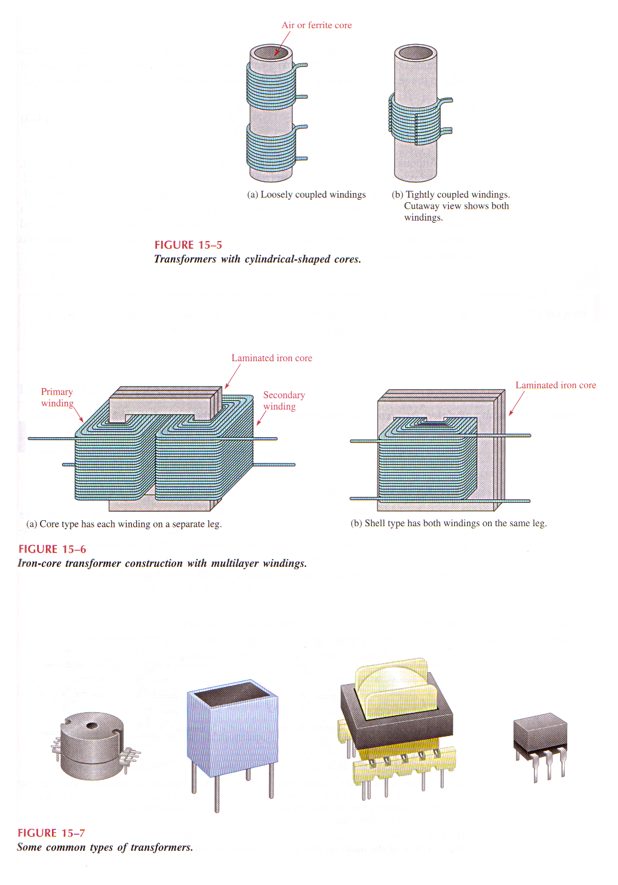
The Basic Transformer Structure
A basic transformer is an electrical device constructed of two coils wound on a common core or frame.
One coil is called the primary winding, and the other is called the secondary winding.

Slide 4
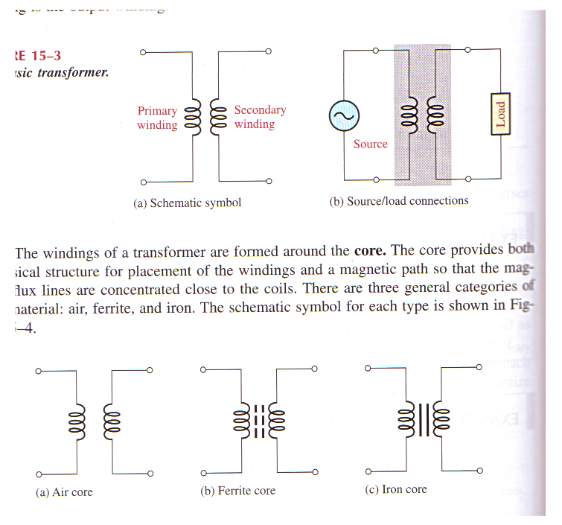

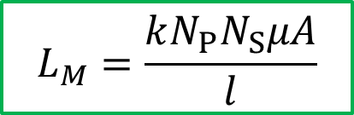
Transformer Core Materials
There are three general categories of core material:
Air
Ferrite
Iron
$$L_{M}=\frac{kN_{P}N_{S}μA}{l}$$
$$v_{ind}=L_{M} \frac{di}{dt}$$
The core of a transformer provides
a physical structure for the windings, and
a magnetic path so that the flux is concentrated close to the coils.

Slide 5
The Basic Transformer Connection
The source voltage is applied to the primary winding, and the load is connected to the secondary winding.
The two coils placed in close proximity to each other so that there is a mutual inductance.

Slide 6
Core material
Air-core and ferrite-core transformers generally are used for high-frequency applications and consist of windings on an insulating shell which is hollow (air) or constructed of ferrite.

Slide 7
Iron-core transformers generally are used for audio frequency (AF) and power applications.

Slide 8
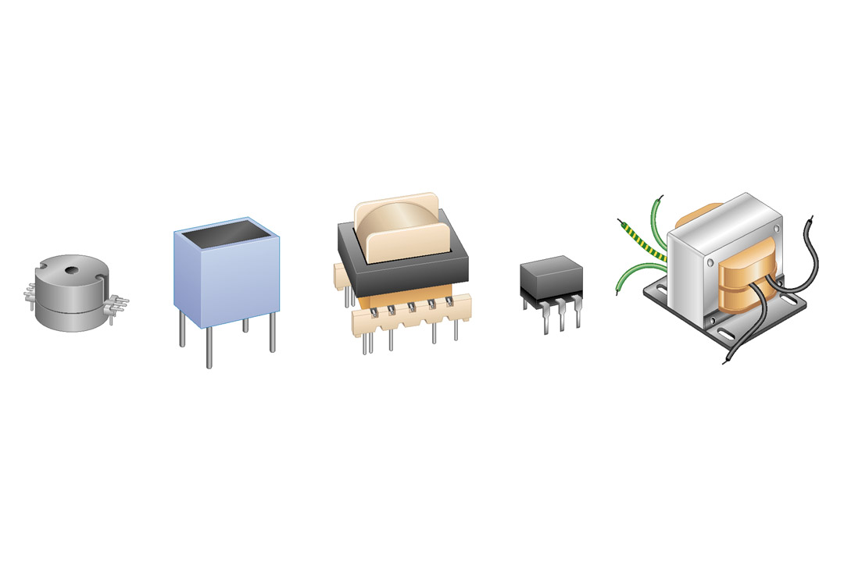
Some different transformers

Slide 9
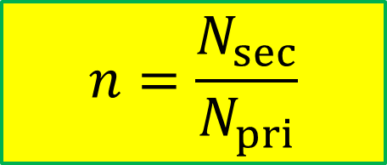
Turns Ratio, n
Defined as the ratio of the number of turns in the secondary winding N_{sec} to the number of turns in the primary winding N_{pri} :
$$n=\frac{N_{sec}}{N_{pri}}$$
The turns ratio of a transformer is rarely specified.
Generally, the primary and secondary voltages and the power rating are the key specifications.

Slide 10
Step-Up Transformer
A transformer in which the secondary voltage is greater than the primary voltage is called a step-up transformer.
The amount that the voltage is stepped up depends on the turns ratio.
The ratio of secondary voltage V_{sec} to primary voltage V_{pri} is equal to the turns ratio.
Step-up transformer V_{sec} > V_{pri}
⇔ N_{sec} > N_{pri}
⇔ n > 1
Notes:
08/22/99
2

Slide 11
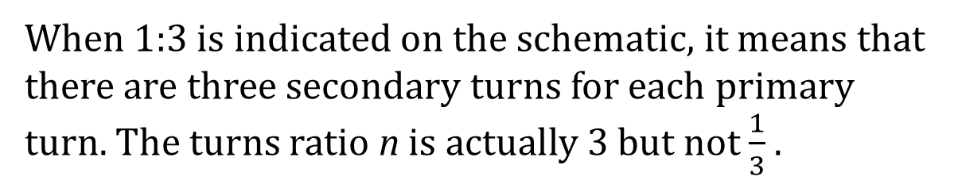
Example
The transformer in the figure below has a 200 turn primary winding and a 600 turn secondary winding. What is the voltage across the secondary winding?
Solution
120 V
When 1:3 is indicated on the schematic, it means that there are three secondary turns for each primary turn. The turns ratio n is actually 3 but not $\frac{1}{3}$ .

Slide 12
Step-Down Transformer
A transformer in which the secondary voltage is less than the primary voltage is called a step-down transformer.
The amount of voltage stepped down depends on the turns ratio.
Step-down transformer V_{sec} < V_{pri}
⇔ N_{sec} < N_{pri}
⇔ n < 1
Notes:
08/22/99
2

Slide 13
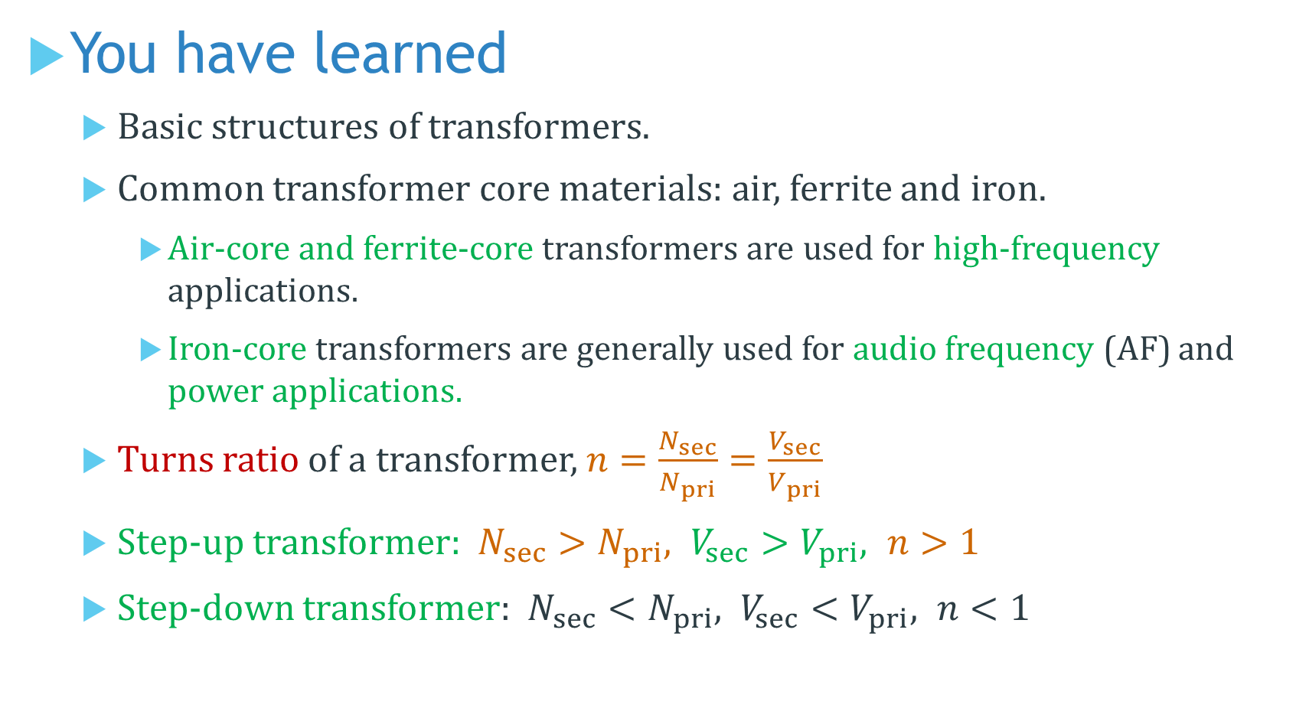
You have learned
Basic structures of transformers.
Common transformer core materials: air, ferrite and iron.
Air-core and ferrite-core transformers are used for high-frequency applications.
Iron-core transformers are generally used for audio frequency (AF) and power applications.
Turns ratio of a transformer, $n=\frac{N_{sec}}{N_{pri}}=\frac{V_{sec}}{V_{pri}}$
Step-up transformer: $N_{sec}>N_{pri}, V_{sec}>V_{pri}, n>1$
Step-down transformer: $N_{sec}<N_{pri}, V_{sec}<V_{pri}, n<1$

Slide 14
Coming Up Next
Transformer Current Ratio & Power

